Slide 1
POWER LINE COMMUNICATION
by;
R SIDDHARTH
2018504607

Slide 2
SYSTEM CONSTRUCTION:
The system consists of four functional units: Decision unit, Data transmission unit, Parameter acquisition unit and Remote welding unit.
1)The parameter acquisition unit monitors the 3D environmental information, hydrological information and welding parameter information and transmits the information to the decision unit.
2)Based on the analysis and processing of collected information, the decision control unit controls the remote welding.
3)Data transmission unit is nothing but the plc unit.
4)And the remote welding unit is the workspace.

Slide 3
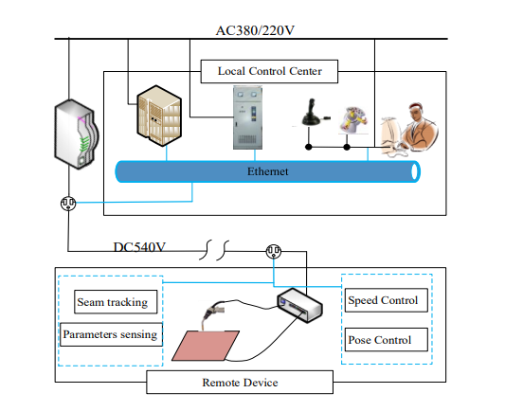
PICTORIAL REPRESENTATION OF REMOTE WELDING USING PLC:

Slide 4
PLC MODULE:
=>The key technologies mainly include digital frequency modulation technology, orthogonal frequency division multiplexing technology and direct sequence spread spectrum technology.
=>These methods should resolve the following issue,
The power line communication unit of the remote welding system is working in the environment of electromagnetic interference. The noise reduction of the power line communication is the first key problem to be solved.

Slide 5
=>This study uses spectrum sensing technology of cognitive radio to avoid noise interference in the channel, so as to achieve effective communication.
Spectrum sensing:The process which checks periodically whether the particular frequency band is available for communication.
Cognitive radio: The method which uses spectrum sensing and move across the frequency bands for communication while avoiding occupied once.
=>The power line communication generally uses cognitive radio OFDM modulation.
This is used not only reduces the mutual interference between the subcarriers, but also improves the spectrum utilization of the channels.

Slide 6
WELDING POWER MODULE:
The power line is a 540 volts DC power cable. In addition to outputting the required voltage for welding, it also provides power for remote power line communication devices and external characteristic controllers.
The external characteristic controller obtains,
=>output voltage amplitude Vset of the welding machine,
=>the no-load voltage V0,
=>arc current Imin,
=>maximum output current Imax,
=>and other parameters such as electric signals, gun position signals, welding motion parameters, and workpiece thickness, temperature, etc.

Slide 7
=>These parameters helps to choose accurate droplet transfer control which is realized and the stability of the welding process is improved.
Droplet transfer mode:
It is affected by voltage and current intensities,electrode polarity,filler wire,shielding gas etc.
Which helps is choosing optimum values of the above there by increasing the stability and quality of the welding joint.

Slide 8
CONCLUSION:
In this study, the application of wire communication technology in the remote welding system will have a positive effect on improving the reliability of offshore construction and has broad application prospects and technological convergence of power line communication, and remote welding.
It will lay a foundation for the application of the remote robot welding technology in the construction of national key engineering.

